Slide 1
Design Space Exploration of Emerging Memory Technologies for Machine Learning Applications
S.M.Shamimul Hasan, Neena Imam, Ramakrishnan Kannan, Srikanth Yoginath, Kuldeep Kurte
Email: {hasans, imamn, kannanr, yoginathsb, kurtekr}@ornl.gov
Computing and Computational Sciences Directorate (CCSD)
Oak Ridge National Laboratory (ORNL), Oak Ridge, TN

Slide 2
Acknowledgements
Support for this work was provided by the United States Department of Defense. We used resources of the Computational Research and Development Programs and the Oak Ridge Leadership Computing Facility at the Oak Ridge National Laboratory, which is supported by the Office of Science of the U.S. Department of Energy under Contract No. DE-AC05-00OR22725.
This manuscript has been authored by UT-Battelle, LLC, under contract DE-AC05-00OR22725 with the US Department of Energy (DOE). The US government retains and the publisher, by accepting the article for publication, acknowledges that the US government retains a nonexclusive, paid-up, irrevocable, worldwide license to publish or reproduce the published form of this manuscript, or allow others to do so, for US government purposes. DOE will provide public access to these results of federally sponsored research in accordance with the DOE Public Access Plan (http://energy.gov/downloads/doe-public-access-plan).

Slide 3
Outline
Motivation
Memory Design Space Exploration Architecture
Experimental Setup
Results
Recommendations

Slide 4
Motivation
Design space exploration (DSE) involves the selection of appropriate configurations to satisfy various performance, power, temperature, reliability, and other metrics
Memory design space exploration methods study memory systems’ performances and limitations before implementation
The computer memory design space has grown exponentially because of the enormous growth of memory types, memory controllers, and application software
Large-scale cycle-accurate architectural simulators are used on representative benchmarks to explore the design space (e.g., Mambo simulation, SimNow simulator)

Slide 5
Motivation
Architectural simulators is extremely slow (in between 1 KIPS and 1 MIPS)
The machine learning (ML) models reduce the simulation time by utilizing a small set of simulated configurations in the training phase
We propose and evaluate a ML-based DSE approach for ML workloads

Slide 6
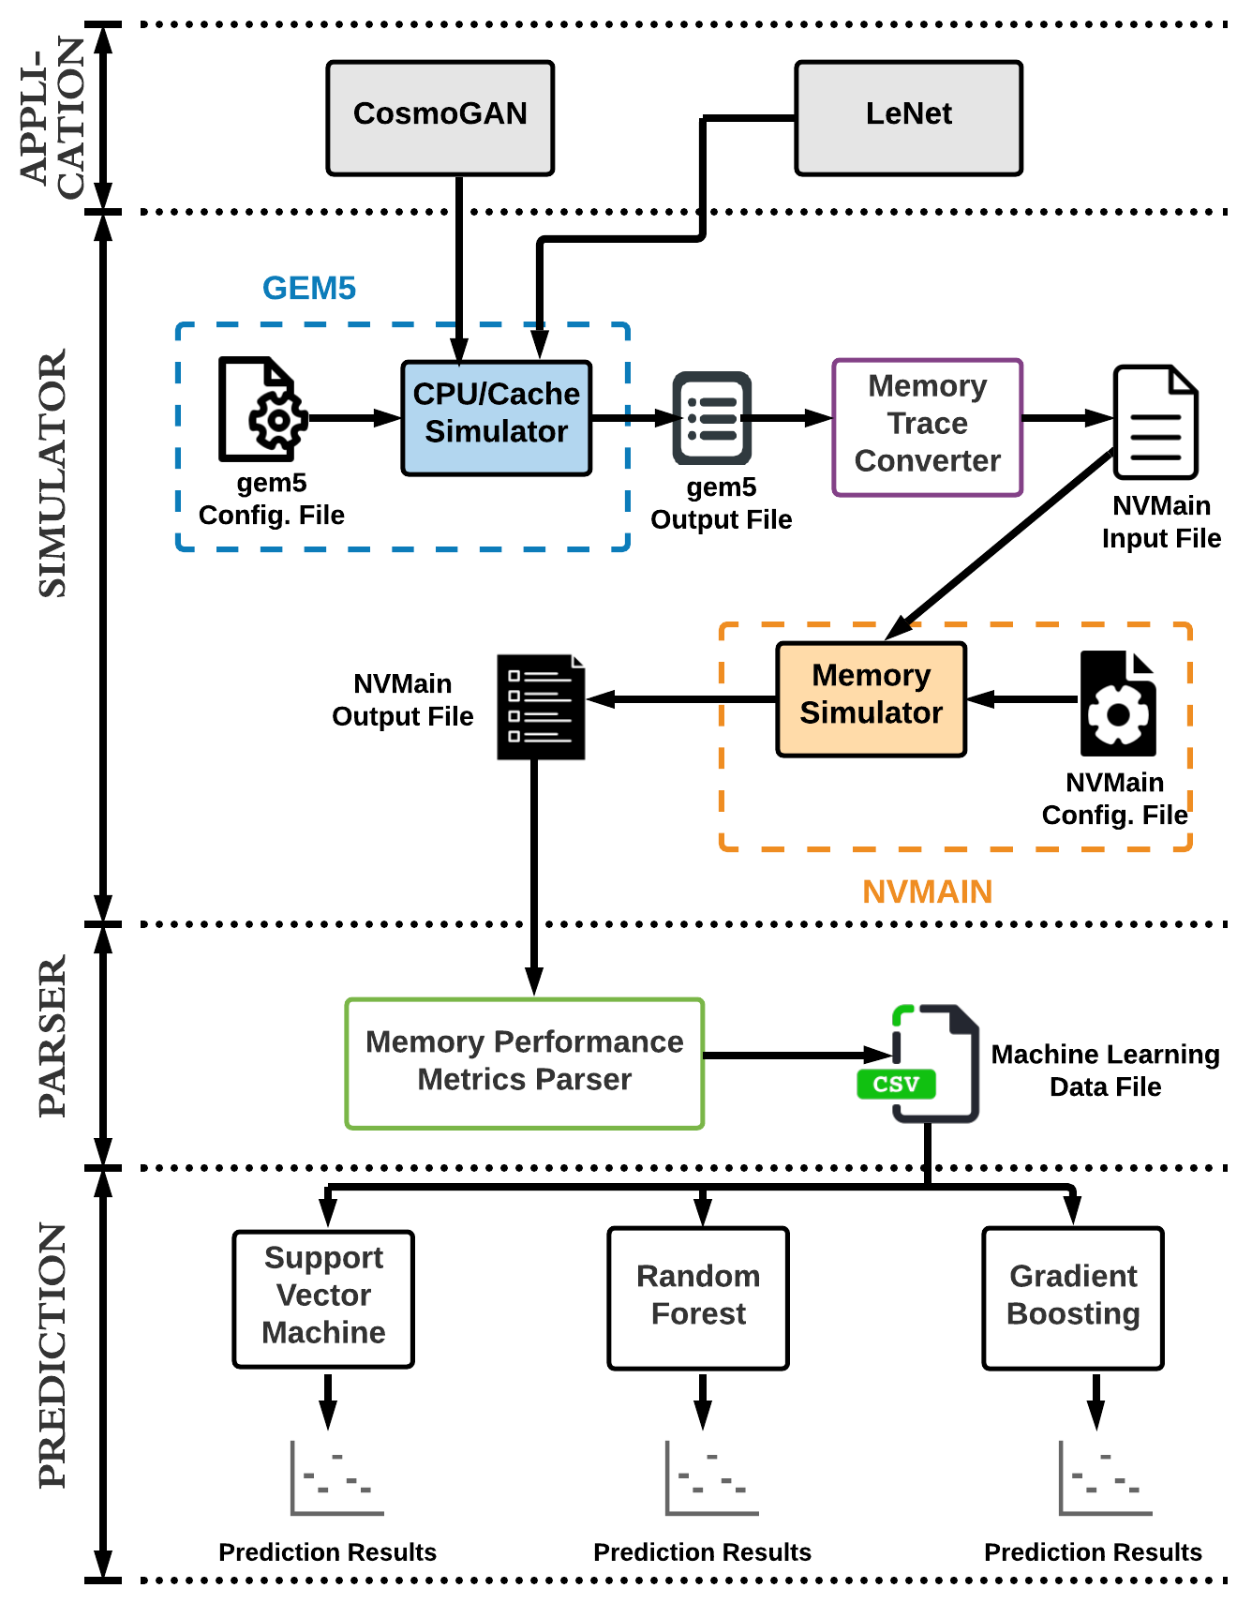
Memory Design Space Exploration Architecture

Slide 7
Memory Design Space Exploration Architecture
Application
CosmoGAN
Exascale Computing Projec (ECP) Exalearn project
Cosmology simulations create virtual universes
CosmoGAN is exploring the use of generative adversarial networks to create cosmological weak lensing convergence maps — maps of the matter density of the universe as would be observed from Earth — at lower computational costs
Researchers employ numerical simulations for theoretical predictions that can be tested using observations
CosmoGAN handles 256X256 pixels image data using eight layers.
https://arxiv.org/pdf/1706.02390.pdf
https://cs.lbl.gov/news-media/news/2019/exalearn-for-surrogates-making-realistic-simulations-on-the-cheap/
Notes:
Exascale computing refers to computing systems capable of at least one exaflop or a billion billion calculations per second (10^18).

Slide 8
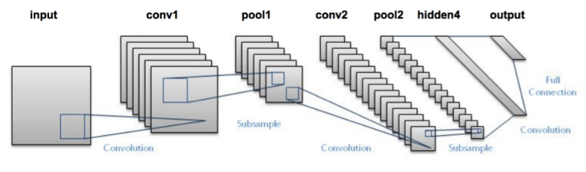
Memory Design Space Exploration Architecture
Application
LeNet
A convolutional neural network which uses fully connected layers, pooling, and convolutions
Used to recognized handwritten digits
LeNet handles 28x28 pixels image data using just two layers
https://www.pyimagesearch.com/2016/08/01/lenet-convolutional-neural-network-in-python/

Slide 9
Memory Design Space Exploration Architecture
Simulator
Gem5
Modular platform for computer-system architecture research, encompassing system-level architecture as well as processor microarchitecture
Two modes
Syscall emulation (SE) mode
Full system (FS) mode
Support various CPU models
Alpha
ARM
Power
X86
The memory traces corresponding to the running of each benchmarks are obtained via trace-based debugging option of gem5

Slide 10
Memory Design Space Exploration Architecture
Simulator
NVMain
NVMain is an architectural-level simulator to model energy and cycle-accurate operations of DRAM, NVM, and their hybrid designs
Parameters
Memory parameters: CHANNELS, RANKS, BANKS, ROWS, COLS, CLK, CPUFreq
Timing parameters: tBURST, tRAS, tRCD, tRP, tWR
MLC parameters: MLCLevels​, SET/RESET pulse times​, number of program pulses to write 00, 01, 10, and 11, etc.
Control parameters: PrintGraphs, PrintPreTrace, EchoPreTrace, TraceReader, InitPD, and others.

Slide 11
Memory Design Space Exploration Architecture
Machine Learning algorithms
Support Vector Machine (SVM)
The Support vector machine (SVM) is a machine learning algorithm that is employed to classify data. SVM is a supervised form of machine learning that assesses data and subsequently splits it between two classifications. The SVM can be extended to solve the regression problem, which is called support vector regression
Random Forest (RF)
The random forest classifier evolves directly from, and consists of, decision trees. To apply a classification to a new instance, every decision tree serves to classify the inputted data. The random forest subsequently collates the categorizations and selects the most common forecast. A sample of data from the original dataset is used as the input for each tree. Furthermore, a subset of features is selected at random from the features that are available to allow the tree to grow at every node without any pruning
https://www.techopedia.com/definition/30364/support-vector-machine-svm
https://www.sciencedirect.com/topics/engineering/random-forest

Slide 12
Memory Design Space Exploration Architecture
Machine Learning algorithms
Gradient Boosting (GB)
Gradient Boosting (GB) method builds the base regression tree based learners sequentially using the residual information. The motivation behind such approach is that, each tree when fitted to the residuals, can improve the overall predictions in areas where the previously grown trees did not perform well. It is to be noted that, as boosting is a sequential approach, the construction of each tree depends strongly on the trees that have already been grown
S. Sen and N. Imam, “Machine learning based design space exploration for hybrid main-memory design,” in Proceedings of the International Symposium on Memory Systems, 2019, pp. 480–489.

Slide 13
Memory Design Space Exploration Architecture
Simulator Setup
NVMain configuration parameter
number of channels
ranks
banks
controller frequency
CPU frequency
data restoration time (tRAS)
row activation time (tRCD)

Slide 14
Memory Design Space Exploration Architecture
Simulator Setup
Memory response parameter
Bandwidth: The bandwidth is the rate at which data can be read from or stored in the memory by a processor. NVMain provides bandwidth in MB/s
Power: The power refers to the total power consumed by the memory measured in Watts (W) during the execution of the workload
Latency: The latency is the time between initiating a request for a byte or word from the memory until it is received by a processor. Lower latency values are preferable. NVMain provides the average latency, average queue latency, and average total latency values. These averages are calculated for each channel. The average total latency is the sum of the average latency and average queue latency values
Memory Read and Write: The purpose of the read operation is to read store data while that of the write operation is to store a new value in the memory. Both the read and write operations require memory addresses

Slide 15
Memory Design Space Exploration Architecture
Parser
Developed a Python script that takes all the NVMain configuration and output files and produces one comprehensive dataset that contains NVMain simulation configuration information and memory response parameter values (bandwidth, power, average latency, average total latency, memory reads, and memory writes)
Prediction
applied Support Vector Machine (SVM), Random Forest (RF), and Gradient Boosting (GB) regression machine learning algorithms
80% of the data was used for training and 20% was used for testing

Slide 16
Experimental Setup
Gem5
CosmoGAN
The epoch to train (parameter name: epoch) = 1
The size of batch images (parameter name: batch_size) = 1
The dimension of noise vector z (parameter name: z_dim) = 8
The number of discriminator convolutional layers (parameter name: nd_layers) = 2
The number of generator conv_T layers (parameter name: ng_layers) = 2
The dimension of gen filters in last conv layer (parameter name: gf_dim) = 8
The dimension of discrim filters in first conv layer (parameter name: df_dim) = 8
Trace file size:190 GB
LeNet
Single iteration of the forward and backward propagation run
Batch size (parameter name: BATCH_SIZE) = 16
Maximum iteration (parameter name: MAX_ITER) = 1
Trace file size: 11 GB

Slide 17
Experimental Setup
NVMain
CosmoGAN gem5 trace created 501 GB of .nvt file
LeNet gem5 trace created 27 GB of .nvt file
Configuration
CPU frequency = 2 GHz
Controller frequency = 400, 666, 1,250, and 1,600 MHz
Number of channels = 2 and 4
tRAS = 24
tRCD = 9, 20, 30, 33, 40, 50, 60, 62, 67, 80, 83, 94, 100, 120, 125, 133, 156, 160, 187, 200, 240, 250, and 320
Machine Learning
Used Scikit-learn tool

Slide 18
Experimental Setup
Hardware
Oak Ridge Leadership Computing Facility’s (OLCF) Rhea supercomputer
Specification:
Architecture: Commodity-type Linux® cluster
Processors:
default partition: dual 8-core Intel® Xeon® E5-2650 @ 2.0 GHz
gpu partition: dual 14-core Intel® Xeon® E5-2695 @ 2.3 GHz
Nodes: 521
Total cores: 8,444
Memory/node:
default partition: 128GB
gpu partition: 1TB
Memory/core:
default partition: 8GB
gpu partition: 36.5GB
Interconnect: 4X FDR Infiniband, 56GB/s max
GPUs: NVIDIA® K80
https://www.olcf.ornl.gov/olcf-resources/compute-systems/rhea/

Slide 19
Results – Bandwidth

Slide 20
Results – Power

Slide 21
Results – Average Latency

Slide 22
Results – Average Total Latency

Slide 23
Results – Memory Reads

Slide 24
Results – Memory Writes

Slide 25
Recommendations
We recommend DRAM architecture for both CosmoGAN and LeNet applications to get better bandwidth performance
We suggest NVM architecture for both CosmoGAN and LeNet for optimized power performance
For both CosmoGAN and LeNet applications, we recommend NVM architecture for better average latency performance
We propose DRAM architecture for optimized average total latency
For CosmoGAN and LeNet applications, we recommend both DRAM and NVM architectures for memory reads and memory writes

Slide 26
Questions?

Slide 27
Thank You

Slide 28
Backup
Column read time (tBURST)
data restoration time (tRAS)
row activation time (tRCD)
precharge time (tRP)
write-to-precharge time (tWR)

Slide 29
Backup
CPUFreq | ControlFreq | frac_NVM_DRAM | nCh | tRAS1 | tRAS2 | tRAS3 | tRAS4 | tRCD1 | tRCD2 | tRCD3 | tRCD4t | mean_avglat | mean_average_total_latency | mean_total_bandwidth | mean_memreads | mean_memwrites | mean_total_power
2000 | 1250 | 0 | 2 | 24 | 24 | 0 | 0 | 9 | 9 | 0 | 0 | 31.83975 | 164.0485 | 8936.93125 | 1476830496 | 124799188 | 0.2367915
2000 | 1250 | 0 | 4 | 24 | 24 | 24 | 24 | 9 | 9 | 9 | 9 | 30.01905 | 141.103 | 5351.9475 | 738415248 | 62399594 | 0.1932905
2000 | 1600 | 0 | 2 | 24 | 24 | 0 | 0 | 9 | 9 | 0 | 0 | 31.83955 | 164.0495 | 10869.4931 | 1476830496 | 124799188 | 0.2316915
2000 | 1600 | 0 | 4 | 24 | 24 | 24 | 24 | 9 | 9 | 9 | 9 | 30.01865 | 141.10325 | 6445.79281 | 738415248 | 62399594 | 0.189811
2000 | 400 | 0 | 2 | 24 | 24 | 0 | 0 | 9 | 9 | 0 | 0 | 31.83965 | 164.049 | 3277.05125 | 1476830496 | 124799188 | 0.2517295
2000 | 400 | 0 | 4 | 24 | 24 | 24 | 24 | 9 | 9 | 9 | 9 | 30.018975 | 141.1065 | 2020.78059 | 738415248 | 62399594 | 0.203887
2000 | 666 | 0 | 2 | 24 | 24 | 0 | 0 | 9 | 9 | 0 | 0 | 31.8397 | 164.049 | 5218.0475 | 1476830496 | 124799188 | 0.2466065
2000 | 666 | 0 | 4 | 24 | 24 | 24 | 24 | 9 | 9 | 9 | 9 | 30.018925 | 141.1045 | 3185.23603 | 738415248 | 62399594 | 0.20018225
2000 | 1250 | 1 | 2 | 0 | 0 | 0 | 0 | 125 | 125 | 0 | 0 | 30.31985 | 579.673 | 5350.24813 | 1476830496 | 124799188 | 0.1241325
2000 | 1250 | 1 | 2 | 0 | 0 | 0 | 0 | 156 | 156 | 0 | 0 | 32.18955 | 648.79 | 4835.09938 | 1476830496 | 124799188 | 0.123022
2000 | 1250 | 1 | 2 | 0 | 0 | 0 | 0 | 187 | 187 | 0 | 0 | 34.06435 | 718.852 | 4404.485 | 1476830496 | 124799188 | 0.122094
2000 | 1250 | 1 | 2 | 0 | 0 | 0 | 0 | 250 | 250 | 0 | 0 | 37.9153 | 863.788 | 3719.07875 | 1476830496 | 124799188 | 0.120618
2000 | 1250 | 1 | 2 | 0 | 0 | 0 | 0 | 62 | 62 | 0 | 0 | 26.6555 | 446.0365 | 6720.46375 | 1476830496 | 124799188 | 0.1270885
2000 | 1250 | 1 | 2 | 0 | 0 | 0 | 0 | 94 | 94 | 0 | 0 | 28.4913 | 512.375 | 5965.7525 | 1476830496 | 124799188 | 0.125459
2000 | 1250 | 1 | 4 | 0 | 0 | 0 | 0 | 125 | 125 | 125 | 125 | 26.90825 | 647.87125 | 3580.45494 | 738415248 | 62399594 | 0.1202135
2000 | 1250 | 1 | 4 | 0 | 0 | 0 | 0 | 156 | 156 | 156 | 156 | 28.08245 | 703.02125 | 3344.84631 | 738415248 | 62399594 | 0.119713
2000 | 1250 | 1 | 4 | 0 | 0 | 0 | 0 | 187 | 187 | 187 | 187 | 29.249675 | 759.4755 | 3132.84344 | 738415248 | 62399594 | 0.11926225
2000 | 1250 | 1 | 4 | 0 | 0 | 0 | 0 | 250 | 250 | 250 | 250 | 31.6643 | 877.3305 | 2766.15972 | 738415248 | 62399594 | 0.11848375
2000 | 1250 | 1 | 4 | 0 | 0 | 0 | 0 | 62 | 62 | 62 | 62 | 24.5566 | 542.96675 | 4125.07878 | 738415248 | 62399594 | 0.12137125
2000 | 1250 | 1 | 4 | 0 | 0 | 0 | 0 | 94 | 94 | 94 | 94 | 25.7438 | 594.292 | 3841.39956 | 738415248 | 62399594 | 0.120768
2000 | 1600 | 1 | 2 | 0 | 0 | 0 | 0 | 120 | 120 | 0 | 0 | 30.02515 | 568.7365 | 6750.85625 | 1476830496 | 124799188 | 0.15868
2000 | 1600 | 1 | 2 | 0 | 0 | 0 | 0 | 160 | 160 | 0 | 0 | 32.4345 | 657.9665 | 5944.74125 | 1476830496 | 124799188 | 0.1569425
2000 | 1600 | 1 | 2 | 0 | 0 | 0 | 0 | 200 | 200 | 0 | 0 | 34.85935 | 748.584 | 5300.905 | 1476830496 | 124799188 | 0.1555555
2000 | 1600 | 1 | 2 | 0 | 0 | 0 | 0 | 240 | 240 | 0 | 0 | 37.29935 | 840.66 | 4775.21688 | 1476830496 | 124799188 | 0.154423

Slide 30
Backup
2000 | 1600 | 1 | 2 | 0 | 0 | 0 | 0 | 320 | 320 | 0 | 0 | 42.22505 | 1027.024 | 3975.49125 | 1476830496 | 124799188 | 0.1527015
2000 | 1600 | 1 | 2 | 0 | 0 | 0 | 0 | 80 | 80 | 0 | 0 | 27.67315 | 482.862 | 7753.52813 | 1476830496 | 124799188 | 0.160842
2000 | 1600 | 1 | 4 | 0 | 0 | 0 | 0 | 120 | 120 | 120 | 120 | 26.722825 | 639.21925 | 4445.45894 | 738415248 | 62399594 | 0.1535815
2000 | 1600 | 1 | 4 | 0 | 0 | 0 | 0 | 160 | 160 | 160 | 160 | 28.2353 | 710.39025 | 4085.39191 | 738415248 | 62399594 | 0.15281625
2000 | 1600 | 1 | 4 | 0 | 0 | 0 | 0 | 200 | 200 | 200 | 200 | 29.747 | 783.5385 | 3769.91947 | 738415248 | 62399594 | 0.1521465
2000 | 1600 | 1 | 4 | 0 | 0 | 0 | 0 | 240 | 240 | 240 | 240 | 31.2783 | 858.371 | 3493.458 | 738415248 | 62399594 | 0.15155925
2000 | 1600 | 1 | 4 | 0 | 0 | 0 | 0 | 320 | 320 | 320 | 320 | 34.3529 | 1011.0705 | 3037.20178 | 738415248 | 62399594 | 0.1505905
2000 | 1600 | 1 | 4 | 0 | 0 | 0 | 0 | 80 | 80 | 80 | 80 | 25.223 | 571.27575 | 4848.15978 | 738415248 | 62399594 | 0.15443725
2000 | 400 | 1 | 2 | 0 | 0 | 0 | 0 | 20 | 20 | 0 | 0 | 24.389 | 367.9145 | 2838.4725 | 1476830496 | 124799188 | 0.04215355
2000 | 400 | 1 | 2 | 0 | 0 | 0 | 0 | 30 | 30 | 0 | 0 | 24.9097 | 385.0095 | 2724.00563 | 1476830496 | 124799188 | 0.0419058
2000 | 400 | 1 | 2 | 0 | 0 | 0 | 0 | 40 | 40 | 0 | 0 | 25.4376 | 403.133 | 2611.44125 | 1476830496 | 124799188 | 0.04166265
2000 | 400 | 1 | 2 | 0 | 0 | 0 | 0 | 50 | 50 | 0 | 0 | 25.9898 | 422.187 | 2502.53 | 1476830496 | 124799188 | 0.04142765
2000 | 400 | 1 | 2 | 0 | 0 | 0 | 0 | 60 | 60 | 0 | 0 | 26.54725 | 442.053 | 2397.63688 | 1476830496 | 124799188 | 0.04120075
2000 | 400 | 1 | 2 | 0 | 0 | 0 | 0 | 80 | 80 | 0 | 0 | 27.6738 | 482.6655 | 2207.27944 | 1476830496 | 124799188 | 0.04078955
2000 | 400 | 1 | 4 | 0 | 0 | 0 | 0 | 20 | 20 | 20 | 20 | 23.03415 | 484.32525 | 1653.19459 | 738415248 | 62399594 | 0.03954705
2000 | 400 | 1 | 4 | 0 | 0 | 0 | 0 | 30 | 30 | 30 | 30 | 23.388575 | 496.991 | 1616.26153 | 738415248 | 62399594 | 0.03946835
2000 | 400 | 1 | 4 | 0 | 0 | 0 | 0 | 40 | 40 | 40 | 40 | 23.7462 | 510.455 | 1578.72944 | 738415248 | 62399594 | 0.03938845
2000 | 400 | 1 | 4 | 0 | 0 | 0 | 0 | 50 | 50 | 50 | 50 | 24.11195 | 524.70975 | 1541.07228 | 738415248 | 62399594 | 0.0393084
2000 | 400 | 1 | 4 | 0 | 0 | 0 | 0 | 60 | 60 | 60 | 60 | 24.483425 | 539.83175 | 1503.08313 | 738415248 | 62399594 | 0.03922755
2000 | 400 | 1 | 4 | 0 | 0 | 0 | 0 | 80 | 80 | 80 | 80 | 25.223375 | 571.05725 | 1429.87725 | 738415248 | 62399594 | 0.03907185
2000 | 666 | 1 | 2 | 0 | 0 | 0 | 0 | 100 | 100 | 0 | 0 | 28.8489 | 525.293 | 3298.21125 | 1476830496 | 124799188 | 0.0671021
2000 | 666 | 1 | 2 | 0 | 0 | 0 | 0 | 133 | 133 | 0 | 0 | 30.79925 | 597.4055 | 2923.47188 | 1476830496 | 124799188 | 0.0662944
2000 | 666 | 1 | 2 | 0 | 0 | 0 | 0 | 33 | 33 | 0 | 0 | 25.0563 | 390.33 | 4317.42938 | 1476830496 | 124799188 | 0.06930295
2000 | 666 | 1 | 2 | 0 | 0 | 0 | 0 | 50 | 50 | 0 | 0 | 25.9898 | 422.231 | 4026.3375 | 1476830496 | 124799188 | 0.0686746
2000 | 666 | 1 | 2 | 0 | 0 | 0 | 0 | 67 | 67 | 0 | 0 | 26.94195 | 456.2435 | 3754.1025 | 1476830496 | 124799188 | 0.06808585
2000 | 666 | 1 | 2 | 0 | 0 | 0 | 0 | 83 | 83 | 0 | 0 | 27.84755 | 489.0305 | 3523.19375 | 1476830496 | 124799188 | 0.06758725
2000 | 666 | 1 | 4 | 0 | 0 | 0 | 0 | 100 | 100 | 100 | 100 | 25.972375 | 604.48025 | 2180.18753 | 738415248 | 62399594 | 0.064628425
2000 | 666 | 1 | 4 | 0 | 0 | 0 | 0 | 133 | 133 | 133 | 133 | 27.209775 | 661.846 | 2012.58516 | 738415248 | 62399594 | 0.064272425
2000 | 666 | 1 | 4 | 0 | 0 | 0 | 0 | 33 | 33 | 33 | 33 | 23.49245 | 501.021 | 2557.84097 | 738415248 | 62399594 | 0.06543185
2000 | 666 | 1 | 4 | 0 | 0 | 0 | 0 | 50 | 50 | 50 | 50 | 24.111975 | 524.76 | 2460.2415 | 738415248 | 62399594 | 0.06522415
2000 | 666 | 1 | 4 | 0 | 0 | 0 | 0 | 67 | 67 | 67 | 67 | 24.743325 | 550.5915 | 2362.253 | 738415248 | 62399594 | 0.0650156
2000 | 666 | 1 | 4 | 0 | 0 | 0 | 0 | 83 | 83 | 83 | 83 | 25.33335 | 575.96725 | 2273.01941 | 738415248 | 62399594 | 0.064825825

Slide 31
Backup – Previous Reference
Sen, Satyabrata, and Neena Imam. "Machine learning based design space exploration for hybrid main-memory design." In Proceedings of the International Symposium on Memory Systems, pp. 480-489. 2019.

